Slide 1
Gold Price Prediction
BY- Amruta Gavhane

Slide 2
1.Problem Statement. 2.Data Sets. 3.Project Objectives: Time Series Analysis Advanced Modelling Trading Strategy Development Market Sentiment Analysis Statistical Analysis 4.Impact of Market Events. 5.Conclusion.

Slide 3
Problem Statement:
This project aims to leverage a comprehensive dataset of daily gold prices spanning from January 19, 2014, to January 22, 2024, obtained from Nasdaq. The dataset encompasses key financial metrics for each trading day, including the opening and closing prices, trading volume, as well as the highest and lowest prices recorded during the day.
Our Goal:
The main goal of the project is to analyze daily gold prices over a ten-year period, using key financial metrics such as opening and closing prices, trading volume, and highest and lowest prices. This analysis aims to identify trends, patterns, and factors influencing gold prices, and develop predictive models for forecasting future gold prices
Challenges :
Data reliability, sentiment subjectivity, correlation interpretation, event identification, and long-term vs. short-term analysis complexity are potential challenges.

Slide 4
Importance:
Empowering investors with data driven strategies in volatile markets
Approach:
Statistical analysis, machine learning, sentiment analysis

Slide 5
Features: Date: A unique identifier for each trading day. Close: Closing price of gold on the respective date. Volume: Gold trading volume on the corresponding date. Open: Opening price of gold on the respective date. High: The highest recorded price of gold during the trading day. Low: The lowest price recorded for gold in the trading day. Target Variable: Close: Closing price of gold on the respective date.

Slide 6
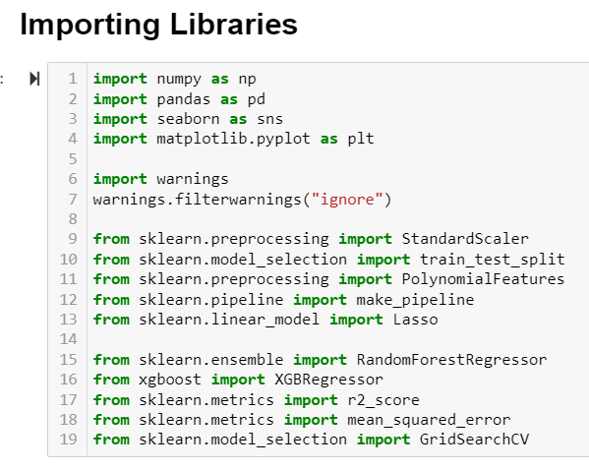
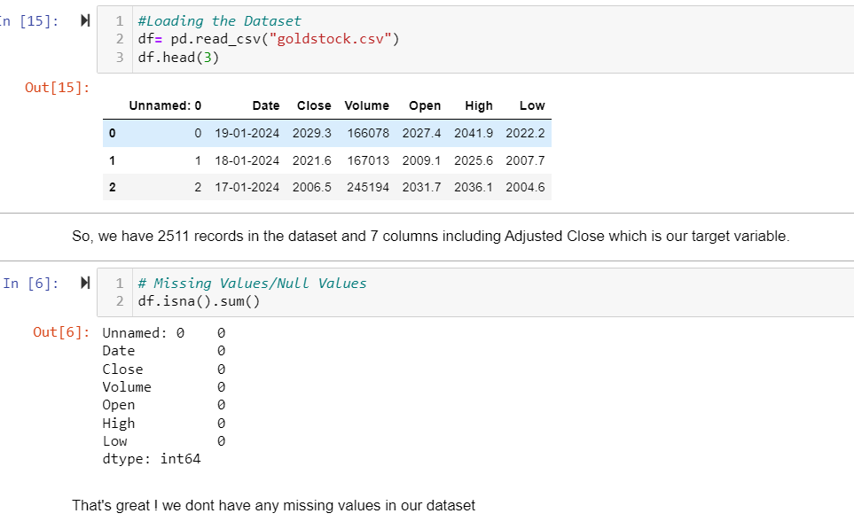
Data Preprocessing: Imported necessary tools and library and load datasets by using pandas. Perform data cleaning activity by Checking missing values, outliers, remove irrelevant column.

Slide 7
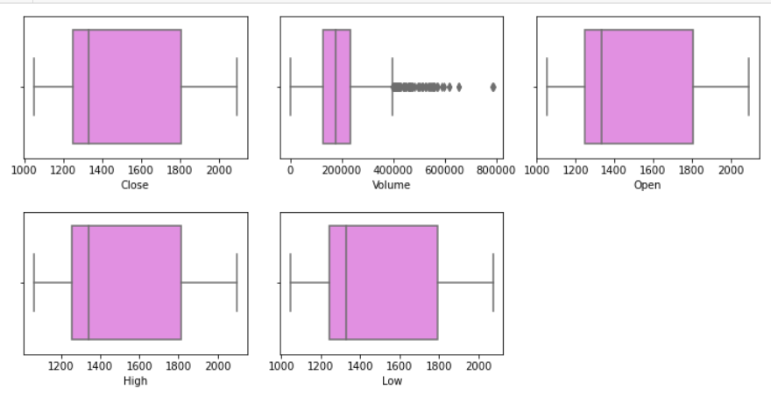
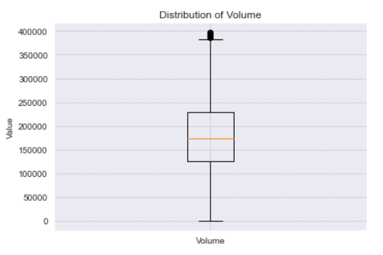
Outliers are in Volume column. Removed Outliers in Volume Column above the upper whisker by using IQR

Slide 8
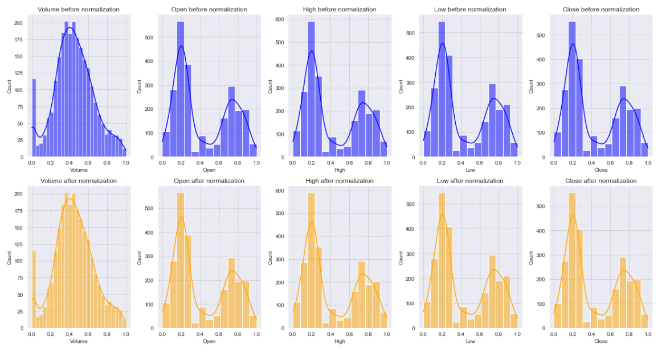
Normalized Numeric Features:

Slide 9
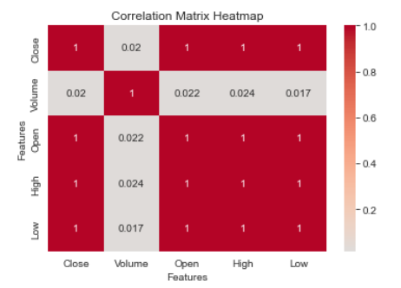
High Correlation Between gold close price and low , open and high Features.

Slide 10
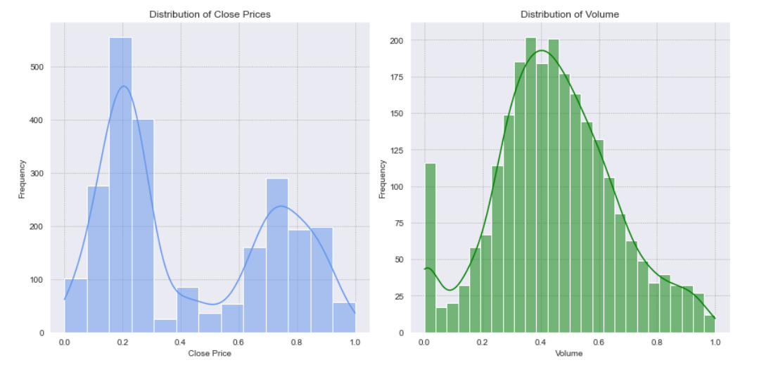
Distribution of Gold price and Volume:

Slide 11
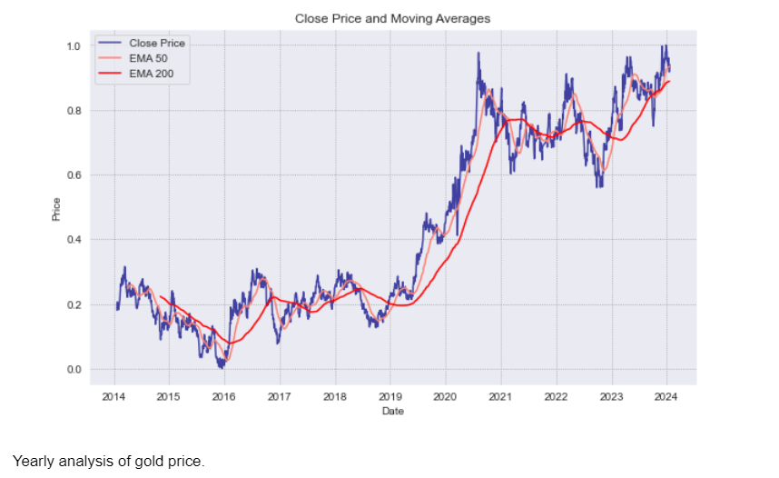
Close price and Moving Average:
Blue line Crossing above orange line: Potential bullish trend, price rising
Blue line crossing below orange line: potential bearish trend, price falling

Slide 12
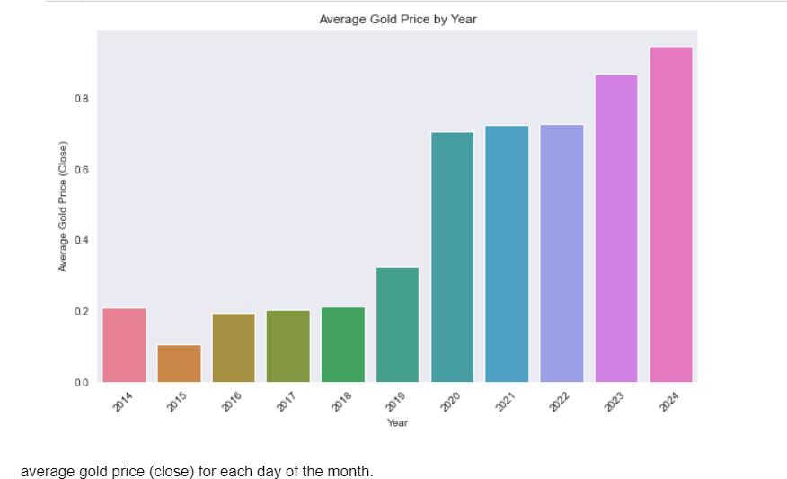
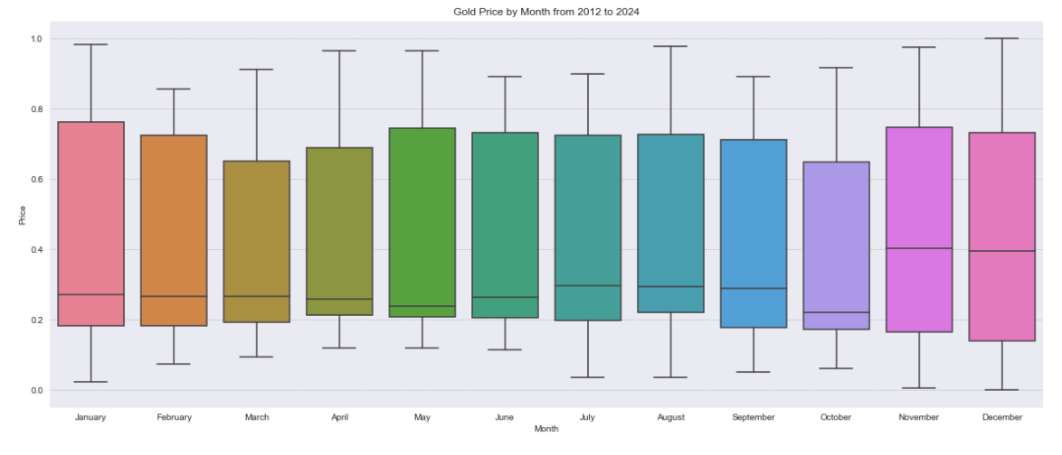
Yearly and Monthly Time Analysis: yearly : gold price are raising by time Monthly: November has high variability of gold price

Slide 13
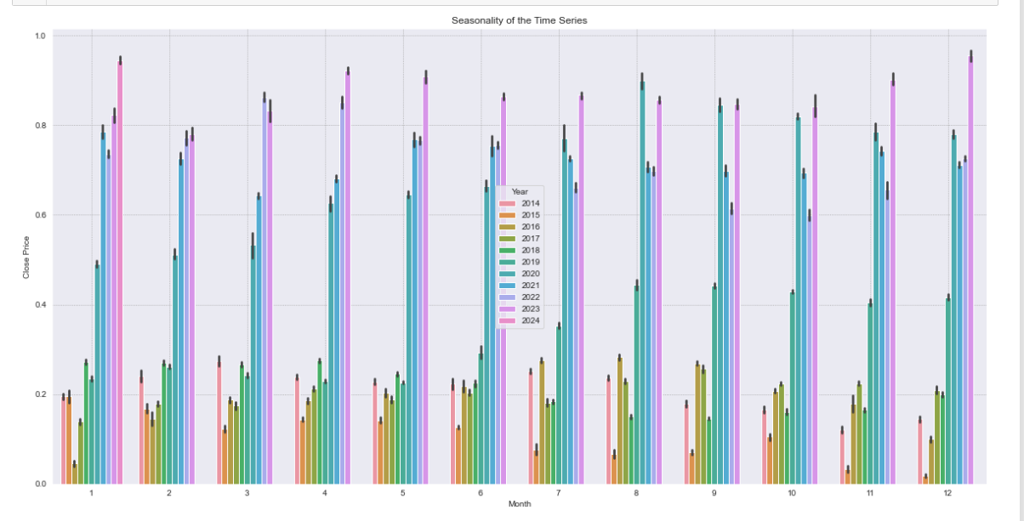
In 2016 the gold prices were low in all months compared to the other year. In August 2020 there was a huge rise in golf prices compared to other month. And gold prices are high across most of the months compared to other years

Slide 14
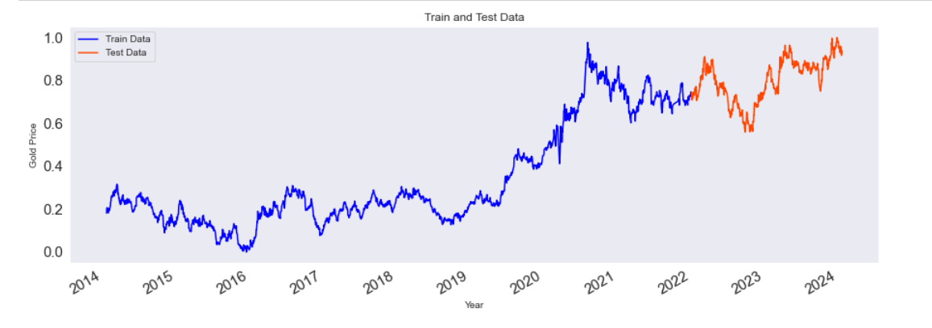
Percentage of training and testing set: train set : 79.15% test set: 20.85%

Slide 15
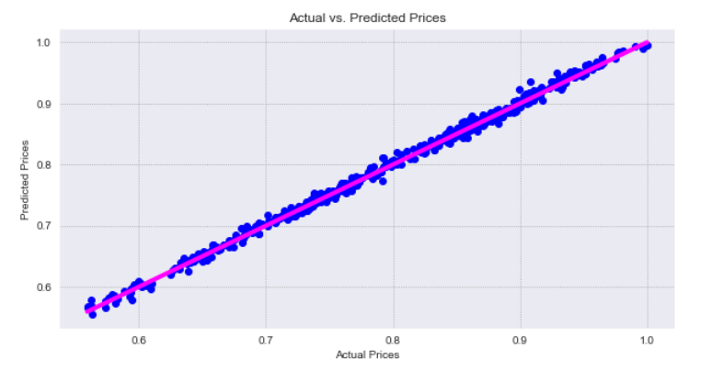
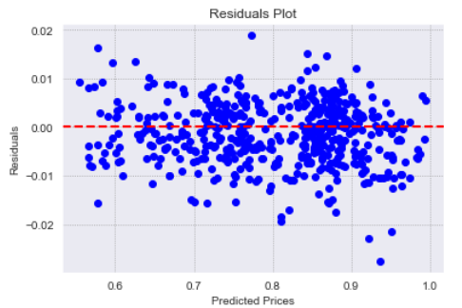
Evaluation Metrics: Best Hyperparameters: {'fit intercept': True, 'positive': False} Mean Squared Error (MSE): 4.263986736042809e-05 Root Mean Squared Error (RMSE): 0.006529920930641357 Mean Absolute Error (MAE): 0.005159467789286419 R-squared (R2): 0.995905881785643

Slide 16
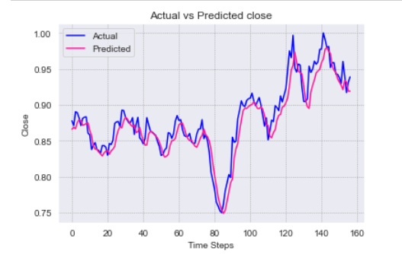
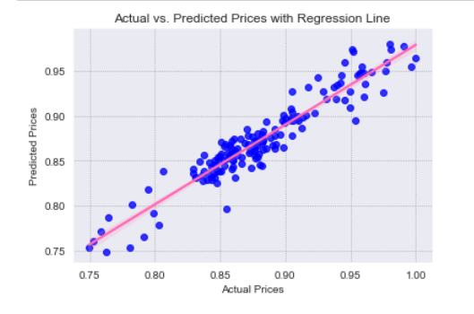
Low MSE (0.000259) on the test set, indicating good overall prediction accuracy. The model explains(R2) nearly 90% of the variance in the actual closing prices

Slide 17
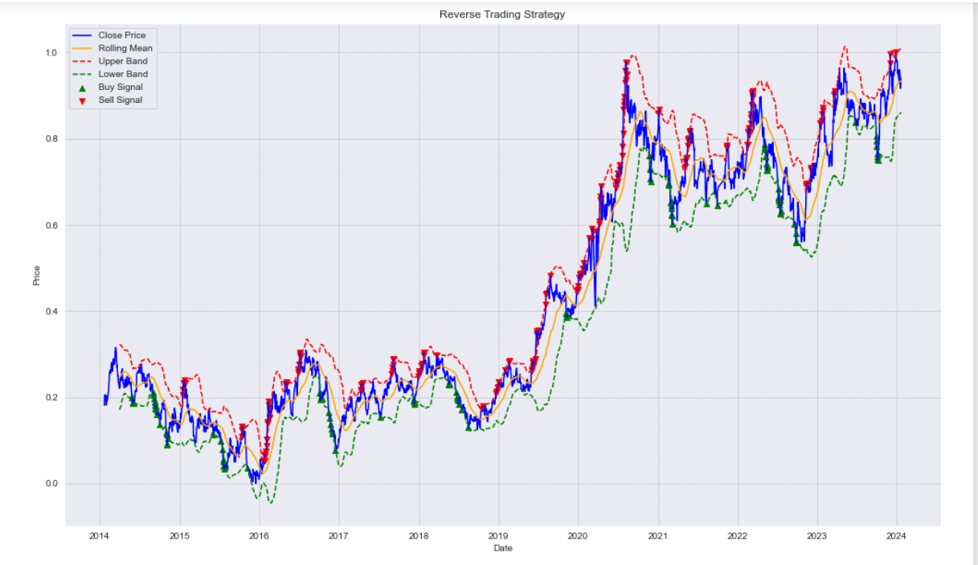
Reverse Trading Strategy:

Slide 18
Conclusion:
The project offers actionable insights and strategies for investors to navigate gold markets effectively. By leveraging advanced analytics and machine learning techniques, investors can make informed decisions and enhance their financial performance in volatile market conditions.

Slide 19
Data Set and Source code:
Data Set:
https://github.com/amrutagavhane/Gold-Price-Prediction/blob/main/goldstock.csv
Source Code:
https://github.com/amrutagavhane/Gold-Price-Prediction/blob/main/Gold%20Price%20Prediction%20-%20Analysis.ipynb

Slide 20
Thank you!!!

